Slide 1


Slide 2

Branching out with Terraform on Google Cloud

Slide 3






master
1.
Deploy app and infra

Slide 4
master
1.
Deploy app and infra
2.
Branch
Deploy branch app and branch infra

Slide 5
master
Rebuild
1.
Deploy app and infra
Destroy
2.
branch
Deploy branch app and branch infra
3.
Accept PR; Merge branch into master

Slide 6




Alexander Brevig
Consultant at Stolt IT
alexander@stoltit.no
Tor Magnus Castberg
Team lead at Entur AS
tor.magnus.castberg@entur.org

Slide 7
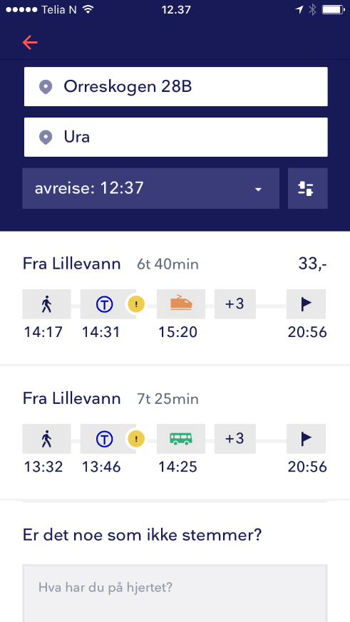
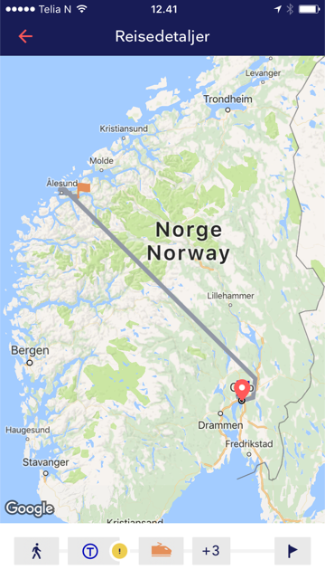



Slide 8

Standard environments
Development
Test
Production

Slide 9
Segmented environments
Segmentation
Customer A
Segmentation
Segmentation
Development
Test
Production
Segmentation
Branch Y
Segmentation
Branch X
Segmentation
Branch Y
Segmentation Branch X

Slide 10
Questions?

Slide 11
Slides and demos from the conference will be available at
https://github.com/nordicinfrastructureconference/2020

